Slide 1
Endothermic and Exothermic Reactions

Slide 2
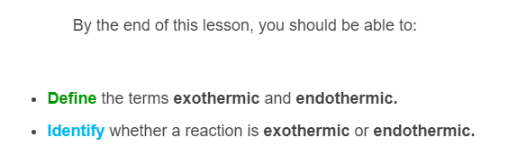
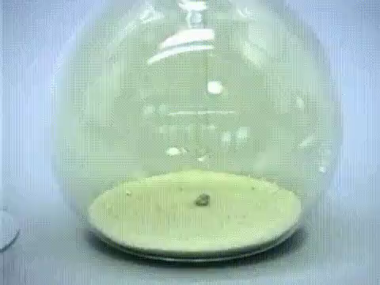

Slide 3
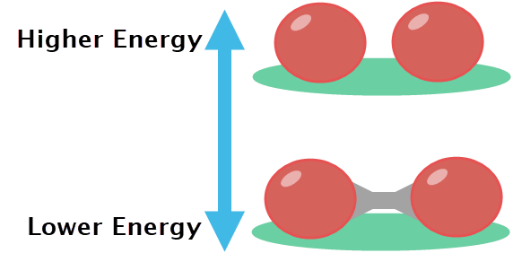
Atoms bond with each other to form molecules and compounds.
A free atom has more energy than a bonded atom.
This means that when bonded, an atom is likely to stay that way, because it would need more energy to be added to break the bond.

Slide 4
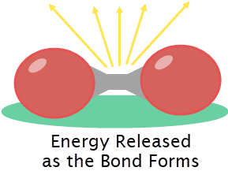
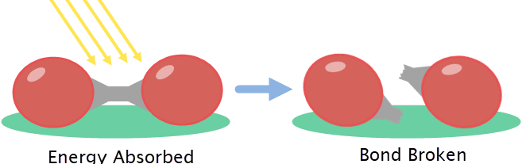
Two free atoms have more energy than the same two atoms bonded together.
This means that energy is lost as the bond is made. Making bonds releases energy.
The opposite is also true - energy must be absorbed for a bond to be broken.

Slide 5
Bond energy is important because chemical reactions involve breaking and forming bonds.
Reactions either release energy or absorb it.
This depends on whether more energy is released by forming bonds or absorbed to break bonds across the course of the reaction.

Slide 6
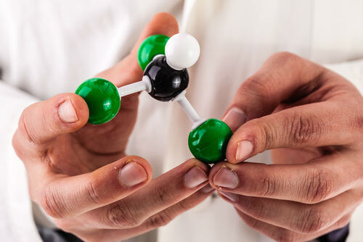
When a reaction occurs, the chemicals change as bonds are broken (absorbing energy) and reformed (releasing energy).
Energy is absorbed by the reaction if more energy in total is used to break bonds.
Energy is released by the reaction if more energy in total is used to form bonds.

Slide 7

When energy is absorbed by a reaction, we call it endothermic.
Endothermic reactions take energy away from their surroundings, and feel cold as a result.
For example, photosynthesis in leaves is a reaction powered by sunlight. It is an endothermic reaction because the energy from sunlight is absorbed to power the reaction.

Slide 8
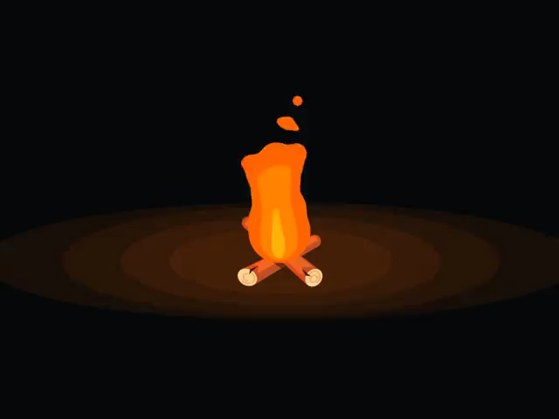
When energy is released by a reaction, we call it exothermic.
Exothermic reactions release energy into their surroundings, and feel hot as a result.
For example, fires are reactions that release huge amounts of heat. They are exothermic reactions because they release energy into the air around them.

Slide 9
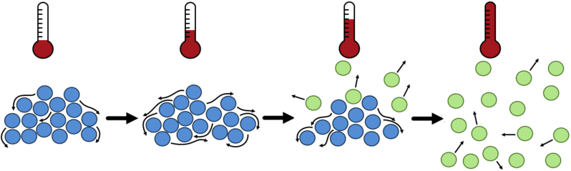
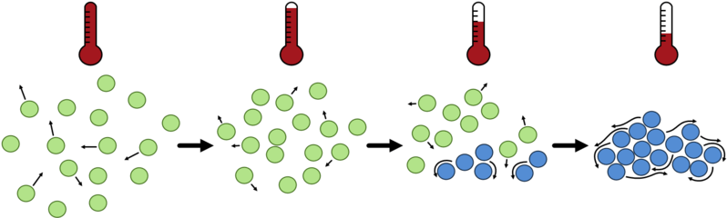
State changes can also be endothermic or exothermic.
Changing from a solid to a liquid to a gas is endothermic.
Changing from a gas to a liquid to a solid is exothermic.

Slide 10
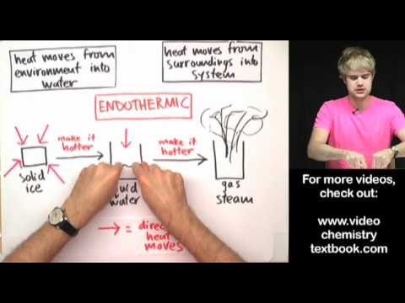

Slide 11
Endothermic State Changes
An increase in temperature will change a substance from a solid to a liquid, and then a liquid to a gas.
The temperature increase is absorbed by the substance, making the processes endothermic.

Slide 12
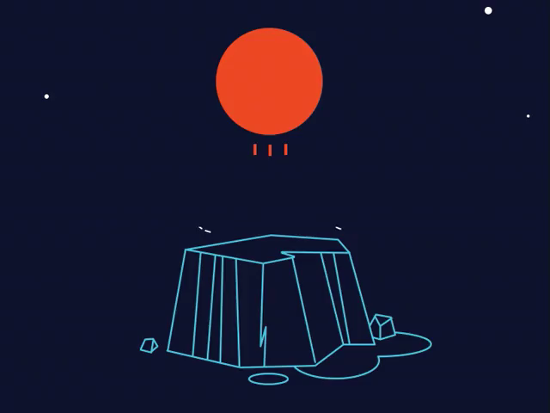
Imagine you have a block of ice. The ice melts as heat is absorbed, forming liquid water.
The liquid water can also absorb heat, from a kettle for example, and this turns it into the gas water vapour.
Heat is absorbed at both stages - these are endothermic processes.

Slide 13
Exothermic State Changes
A decrease in temperature will change a substance from a gas to a liquid, and then a liquid to a solid.
Heat is released by the substance into its surroundings, making it colder. This makes the process exothermic.

Slide 14
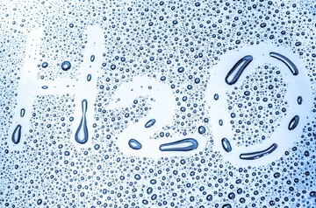
If water vapour comes into contact with cold glass, it releases heat into the glass. This makes it condense and form liquid water.
If it gets colder, the liquid water will release more heat into its surroundings. This will cause the water to freeze into solid ice.
Heat is released at both stages - these are exothermic processes.

Slide 15
